Slide 1


ArcGIS API for Python
Rohit Singh
Atma Mani
Notes:
Esri Corporate Template-Dark v3.3
16:9 version – January 21, 2016
For more templates, sample files, and icons, see https://compass.esri.com/resources/presentations/Pages/Main.aspx
To add footer text in Windows
On the Home tab, under Insert, click Text, and then click Header and Footer.
Click the Slide tab, select the Footer check box, and then type the footer text that you want.
Click either Apply or Apply to All.
To add footer text on a Mac
On the View menu, select Header and Footer.
Select the Footer check box and then type the footer text that you want.
Click either Apply or Apply to All.
If footers don't appear on the slides
If footers don't appear on title slides, in the Header and Footer dialog box make sure the Don't show on title slide check box is not selected.
If the footers are missing from other slides, the placeholders for these items might have been removed from specific slide layouts or the slide master.

Slide 2
ArcGIS Python API
What is it?
Python API to your Web GIS
Powerful, modern and easy to use
Implemented using REST + local capabilities

Slide 3
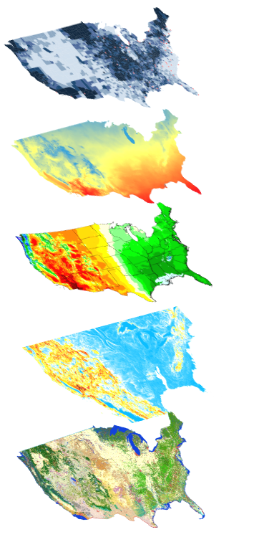
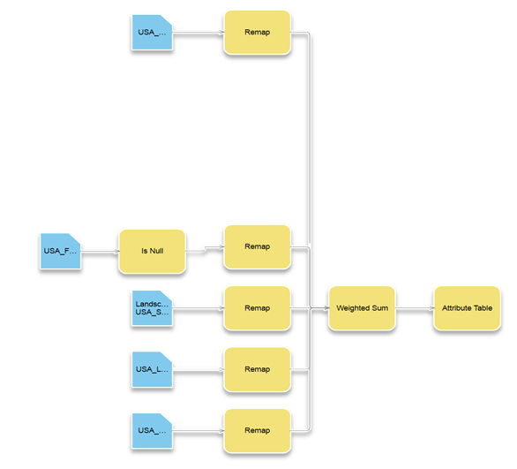
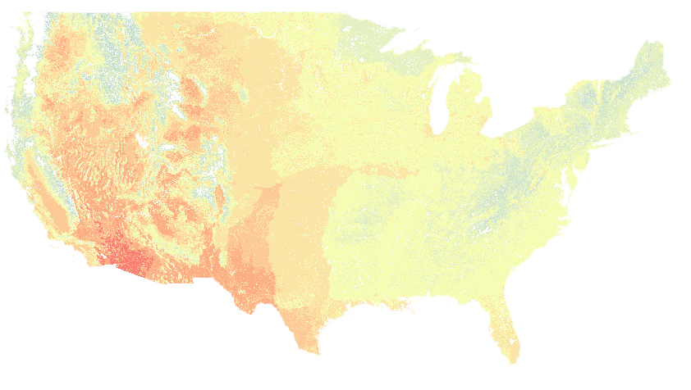

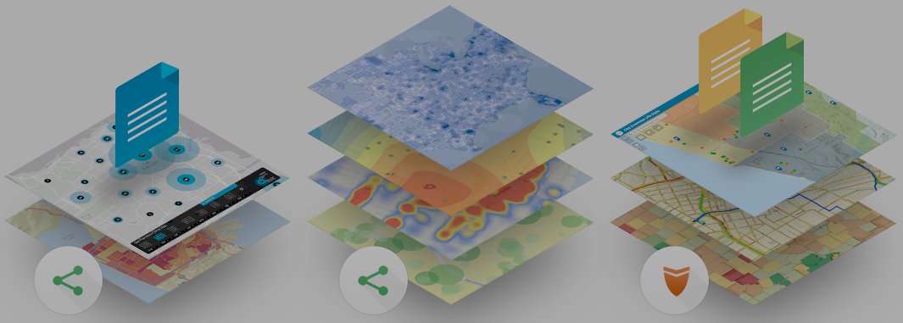
ArcGIS Python API
Big Data
Spatial Analysis
Raster Analytics
What can it do for you?
Imagery
Location Analytics
Feature Analytics
Platform API
Developers
Analysts
Data Scientists
Enterprise Integration
Users, Roles & Group management
Administrators
DevOps
Content Publishers
Your Web GIS
Script and automate your Web GIS
Data Management

Slide 4
Administrators
Automate WebGIS management
Populate portal with users, groups
Clone portals
Reassign user content
Perform comprehensive content search
Determine item relationship
Create reports of users, their items
Notes:
How can all 3 personas benefit from the API?
- Admins, instead of using the UI and getting distracted from their work, can automate most of their common workflows as scripts and schedule them to run at periodic intervals
- Publishers can take care of repetitive content creation and content validation workflows through scripts and schedule them to run at known times
- scientists all over in every discipline love the Jupyter notebook environment. We have added our own enhancements in the form of widgets. Analysts can prototype algorithms, inspect datasets, and visualize their datasets. They can finally share all their work, notes, outputs as Jupyter notebooks, or publish them as html pages to their blogs.

Slide 5
Demo
Interactive
Exploration
Automated deployment of distributed GIS
Big Data GeoAnalytics
Spatial Analysis & Geoprocessing

Slide 6
Content Publishing/management
Automate content creation
Automate content publishing during off peak hours
Update tiles and features from a known database
Replicate development environment content to production
Inspect and update items with broken service links
Notes:
How can all 3 personas benefit from the API?
- Admins, instead of using the UI and getting distracted from their work, can automate most of their common workflows as scripts and schedule them to run at periodic intervals
- Publishers can take care of repetitive content creation and content validation workflows through scripts and schedule them to run at known times
- scientists all over in every discipline love the Jupyter notebook environment. We have added our own enhancements in the form of widgets. Analysts can prototype algorithms, inspect datasets, and visualize their datasets. They can finally share all their work, notes, outputs as Jupyter notebooks, or publish them as html pages to their blogs.

Slide 7
Demo
Interactive
Exploration
Big Data GeoAnalytics
Keeping content up to date
Spatial Analysis & Geoprocessing

Slide 8
Developer
Developer
Develop focussed applications
Integrate with other libraries
Bring GIS into other applications
Notes:
How can all 3 personas benefit from the API?
- Admins, instead of using the UI and getting distracted from their work, can automate most of their common workflows as scripts and schedule them to run at periodic intervals
- Publishers can take care of repetitive content creation and content validation workflows through scripts and schedule them to run at known times
- scientists all over in every discipline love the Jupyter notebook environment. We have added our own enhancements in the form of widgets. Analysts can prototype algorithms, inspect datasets, and visualize their datasets. They can finally share all their work, notes, outputs as Jupyter notebooks, or publish them as html pages to their blogs.

Slide 9
Demo
Interactive
Exploration
Big Data GeoAnalytics
NDVI difference
Spatial Analysis & Geoprocessing

Slide 10
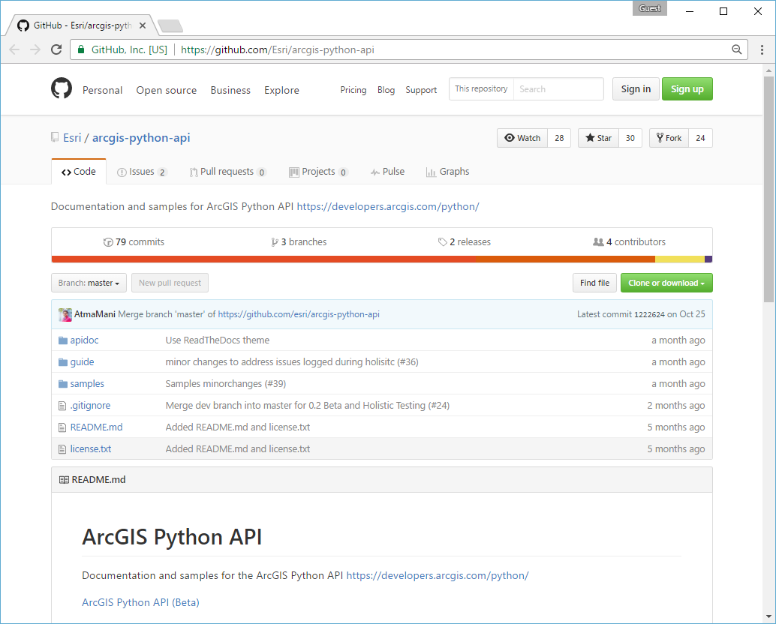
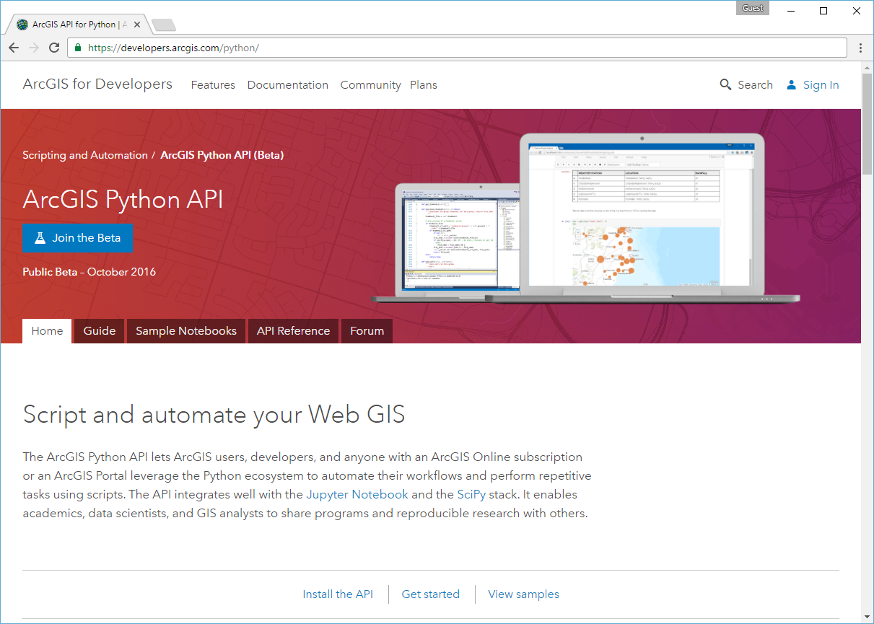
Resources
github.com/Esri/arcgis-python-api
developers.arcgis.com/python

Slide 11
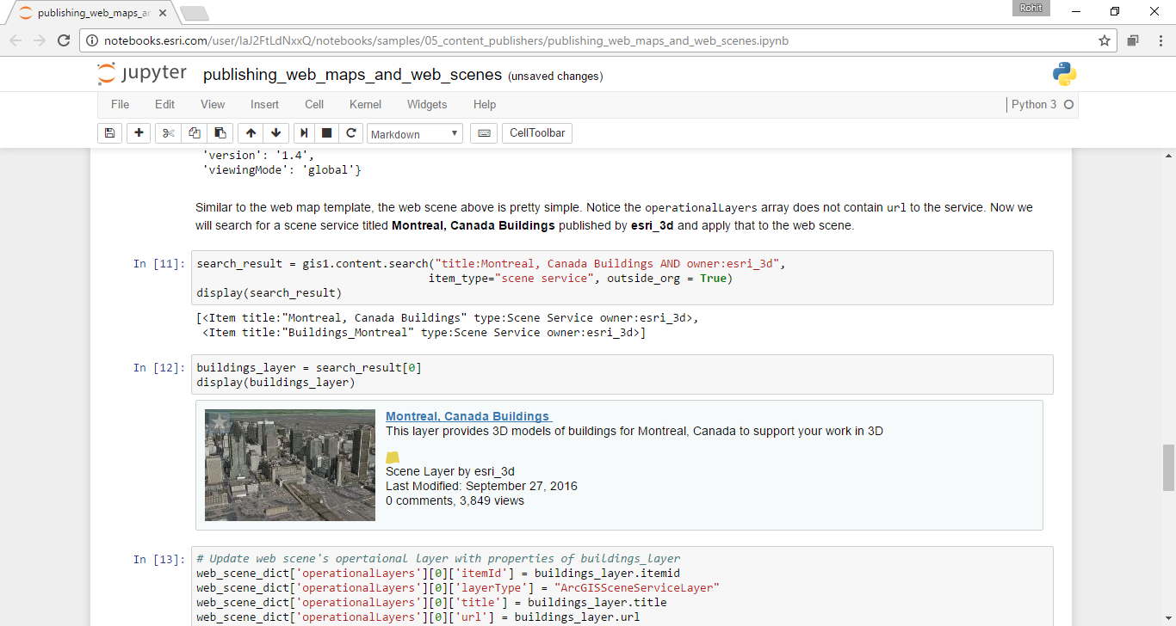
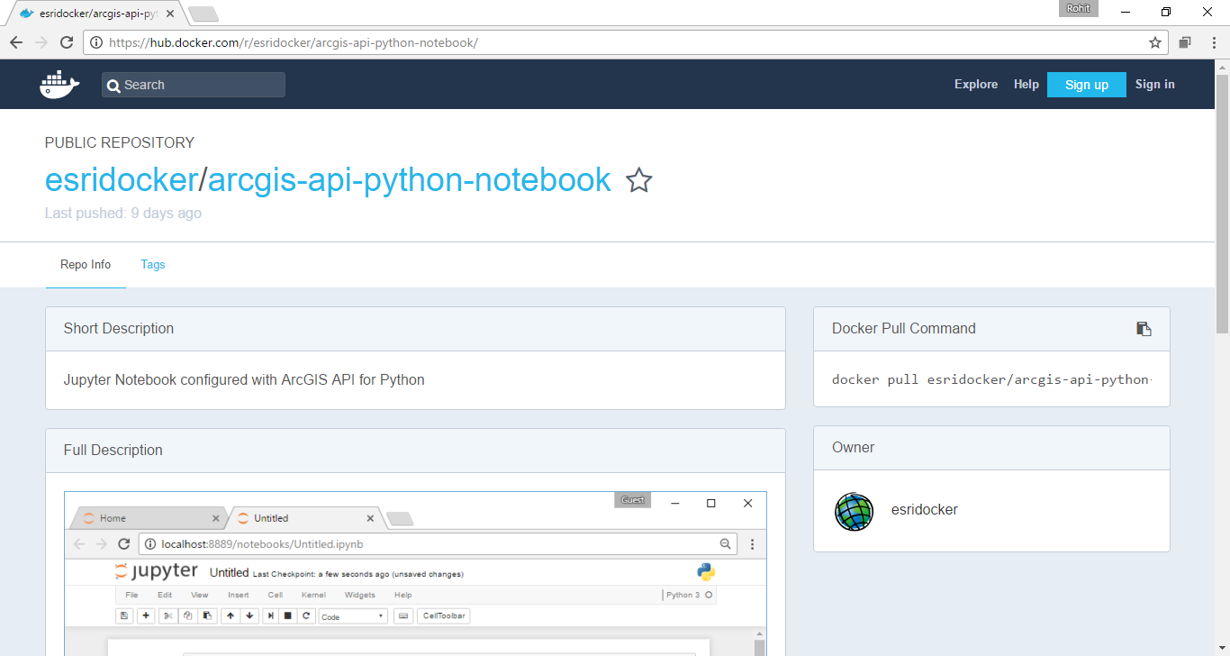
Resources
Notebooks.esri.com
hub.docker.com/r/esridocker

Slide 12
Stats conda split by package conda split by platform (Windows vs OSX and Linux) %age split between analysts and admins/content publishers
Survey results
Quotes

Slide 13
Questions?

